Slide 1
Credit Card Fraud Detection
KI Bonus Projekt WS 19/20

Slide 2
Beschreibung der Daten / des Anwendungsfalls
TODO Salar

Slide 3
Intro
Data is highly imbalanced:
99.83 % normal transactions
00.17 % fraudulent transactions
Possibilities:
Work on full imbalanced data set
Computationally expensive
Work on subset of imbalanced data set
Work on undersampled data set
Lot of information dismissed
Work on full over-sampled data set
Computationally very expensive
Work on subset of over-sampled data

Slide 4
Metriken
TODO (Recall erklären und warum das die richtige Metrik ist) Andrej

Slide 5
Idea
Standard method for binary classification:
Logistic Regression
Random Forest
SVM
XGBoost
Test them on the different datasets
Full and imbalanced set (1)
Full and imbalanced set + Autoencoder (2)
Under-sampled set (3)
Over-sampled set (4)

Slide 6
Outlier Analyse
TODO Marcel

Slide 7
Outlier Ergebnisse
TODO Jan

Slide 8
Data preparation
Completely untouched by sampling techniques to allow meaningful evaluation
Test Set
Full data set
Scaled data set
Scale
Split
Train Set
We scale ‚Amount‘ and ‚Time‘. Other features are a result of PCA and have already been standardized.

Slide 9
Option 1: Logistic Regression
Train Set
Trained Model
Test Set
K-Fold CV
Evaluate
Results

Slide 11
Option 2: Logistic Regression + Autoencoder
AE Set
Trained AE
Train
Train set
Split
Clf set
Predict
Latent repr
Results
Trained Model
Test Set
CV
Evaluate

Slide 13
Options 3 + 4: Over/Under-sampling
Train Set
Test
Set
K-Fold CV
Training
Validation
Fold 1
Fold 2
Fold…
Fold n
Best Model
Results
Note: by sampling during CV we avoid data leakage
Evaluate
Sample
Validate
Sampled Train Set
Train
Trained Model

Slide 15
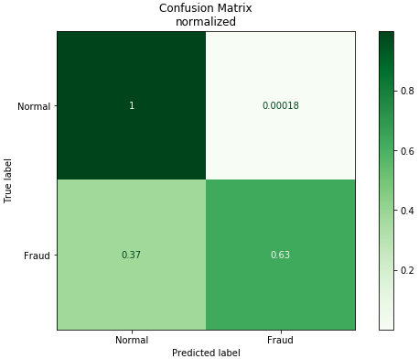
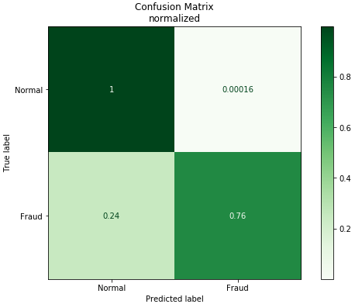
Evaluation
Logistic Regression:
Low rate of false positives
High rate of false negatives
Autoencoder + Logistic Regression:
Similarly low rate of false positives
Lower rate of false negatives, but still too high

Slide 16

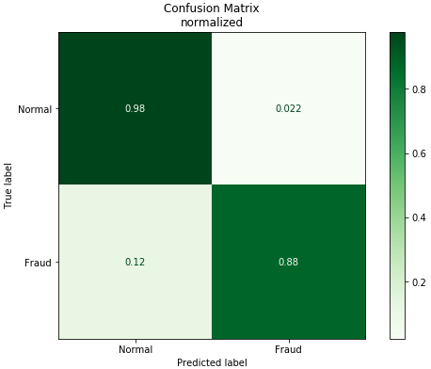
Evaluation
Undersampling + Logistic Regression:
Significantly higher rate of false positives
Even lower rate of false negatives
Oversampling + Logistic Regression:
Highest rate of false positives
Lowest rate of false negatives
Best fit for real world usage (out of selected methods)

Slide 17
SHAP
Lukas

